Slide 1
Causes of the American Revolution
Learning Target: I am learning about cause and effect relationships that led to the American Revolution. Today, I will analyze vocabulary that will help me understand these causes.

Slide 2
Success Criteria
Students will be able to explain the causes of the American Revolution and the effects these had on establishing independence for America.
The purpose is for students to understand how the past has influenced our society today.
This means students will be able to participate in vocabulary activities about the Causes of the Revolution.

Slide 3
Causes of the American Revolution
Know | Want | Questions
What do I know about why the colonists went to war against the British? | Preview Ch 5 (pgs 63-76) Skim the pictures and captions. What 1 picture stands out? What do you notice? What do you wonder? | After you have previewed this chapter. what 1 or 2 questions come to mind about the Causes of the American Revolution?
Notes:
Discuss with a neighbor

Slide 4
Thur Warm Up 9/22
Longer Warm Up: 10 minutes total
Close Read 5.1 (pg 63) Independent Read
Question: How do you believe colonists became so divided in their feelings about the British?

Slide 5
Key Vocabulary
Patriots
Loyalists
Allies
Militia
Tyranny
Repeal
Boycott
Taxes
Massacre
Revolution

Slide 6
Causes of the Revolution Vocab
Activities Page
Read the word from the text (Chapter 5)
Put the definition on your paper in 6 words or less.
Highlight the key word in the definition.
Using at least 5 of your vocab words, create a summary that answers the following question.
Based on what you know from your vocab, what caused the American Revolution?

Slide 7
Causes Vocabulary
Patriots: a person who vigorously supports their country and is prepared to defend it against enemies or detractors.
Loyalists: American colonists who remained loyal to Great Britain during the Revolutionary War.
Allies: a nation that joins another nation in some common effort, like winning a war.
Militia: a small army made up of ordinary citizens who are available to fight in an emergency.
Tyranny: The unjust use of government power.
Repeal: to take back, or to cancel, a law.
Boycott: to refuse to buy one or more goods from a certain source.
Taxes: a required payment of money made to the government.
Massacre: the unnecessary, indiscriminate killing of a large number of human beings or animals, as in barbarous warfare or persecution or for revenge or plunder. .
Revolution: an overthrow and thorough replacement of an established government or political system by the people governed.

Slide 8
Dice Game
2-3 people
Assign a number to each of the vocab words (2-11) (12 is a Daily Double)
50 pts for every correct answer
You roll, you answer. No using your notes(you can check after you answer)
Round 1: Give them the definition, they give you the word.
Round 2: Give them the word, they need to give you the definition
Round 3: One Word Association
Round 4: Sentence

Slide 9
Friday Warm Up 9/23
Using at least 3 of your vocab words, create a quick summary that answers the following question.
Based on what you know from your vocab, what do you believe caused the American Revolution?

Slide 10
Video Focus: Friday
Video: French and Indian War Changes Fate of America
How do you believe the French and Indian War changed the Fate of America?.
What causes do you see in the video that might have led to a Revolution?

Slide 11
Close Read
Read pg. 64 and 65 5.2 Before 1763
Questioner/Respondent
Good and Bad Question Examples….What’s the difference?
Activities Section-Cornell Notes
1. Describe the growth of the colonies around 1750.
2. Describe the conflict in the Ohio Valley. What was going on in this area?

Slide 12
Mon Warm Up 9/26
Define what cause and effect means? Give an example. Use complete sentences.
Because the Broncos were well prepared in practice, they were able to beat the Cincinnati Bengals 29-17.
I did not turn in my homework, ________________________________________________________________________________________________
Activities Section: Cause and Effect: a relationship between actions or events such that one or more are the result of the other or others.

Slide 13
LT: I can explain the cause and effect relationship of the events leading up to the American Revolution.
DOMINOS-3 Pieces of Blank Paper. These are where you final analysis will go. (Final Draft)
2. Use your spiral as a rough draft for finding your 5’W
3. Start with French and Indian War Final (Domino #1) (5W’s and Summary)

Slide 14
French/Indian War:Pg 65
RE-READ THE EVENT FIRST, Then go back to do your event domino.
Who:
What:
When:
Where:
Why is it a cause of the American Revolution?
4-5 Sentence Summary that answers these 5 W’s

Slide 15
Recap of French and Indian War
Who fought?
The French, with help from the Native Americans, fought against the British
G. Washington was a British commander
What were they fighting for?
They were fighting for control over the Ohio Valley
They were also fighting because they hated each other
When were they fighting?
1755-1763

Slide 16
Recap of French and Indian War
Where were they fighting?
Ohio Valley, Canada
Why is this significant?
The British won the war
France gave them much of North America. More land
The colonists helped the British win, and they were excited for the future
Debt...Tax the colonists

Slide 17
Warm Up Tuesday
Turn to page 66
Look at the map and read the caption next to it.
Based on what you see and read the caption, why do you believe colonists would be upset by this?

Slide 18
MO Bucks/Taxes
What are Mo Bucks? What is the purpose of doing these?
Participate please! You
Wednesdays are TAX DAY $$$
Start with 7. You're responsible. Finding them in other classes and in the hallway!!!
Pencil Pouch?? Don’t keep in your locker or bring home.
MO Buck groups. Class competition. Groups of 4. Your Row/Table.
Circle of Trust. Please do not steal anyone else’s Mo Bucks
Prizes at the end of the 1st Quarter

Slide 19
Class Taxes
Talking Tax
Tardy Tax
Tipping Tax

Slide 20
Proclamation of 1763
Who was involved?
What did this Proclamation say? What was the main idea?
Where is this taking place?
When did this event occur?
Why did this anger colonists? Why is this a cause for the Revolution?

Slide 21
Ticket Out
You’ve learned about the French and Indian War
First domino
Today you’ve learned about the Proclamation of 1763
Second domino
Ticket Out:
How did the ‘first domino’ lead to the knocking down of the ‘second domino?’

Slide 22
Warm Up Wed
If you could voice your concern for change about something here at Stuart, what would you say and how would you go about doing it?
Wed Agenda
Goal=Up through Townshend Acts at least!!
Partner Progress

Slide 23
Stamp Act/Townshend Acts
Who was involved?
What happened with this act?
When did this happen?
Where was this happening?
Why is this a cause for the Revolution?

Slide 24
Thur Warm UP 9/29
Townshend Acts: Using these 3 words describe what happened with the Townshend Acts??
Tax
Boycott
Parliament

Slide 25
Causes of the American Revolution Dominos
French/Indian War: Monday
Proclamation of 1763: Tuesday
Stamp Act : Tuesday
Townshend Act: Wed
Boston Massacre: Thur-Tuei
Tea Act:Wed
Boston Tea Party: Thur/Fri
Intolerable Acts:Mon Oct 10th
Lexington/Concord: Tue Oct 11th

Slide 26
Domino Requirements
Read the section.
Describe the 5 W’s in the Domino.
Write a SHORT summary of the event.

Slide 27
Boston Massacre
New Activities Pages
DBQ: Was the Boston Massacre a defenseless killing or an act of self-defense??
Write this at the top of your page and highlight!!
The Boston Massacre Process
Video #1 Overview of Event. Notes
Background of the Boston Massacre-Talk and Share. Lineup and 5 W’s (Skip the Summary)
Document Analysis
Video #2 British Perspective
CER-Graphic Organizer
Final Draft of BM Paper

Slide 28
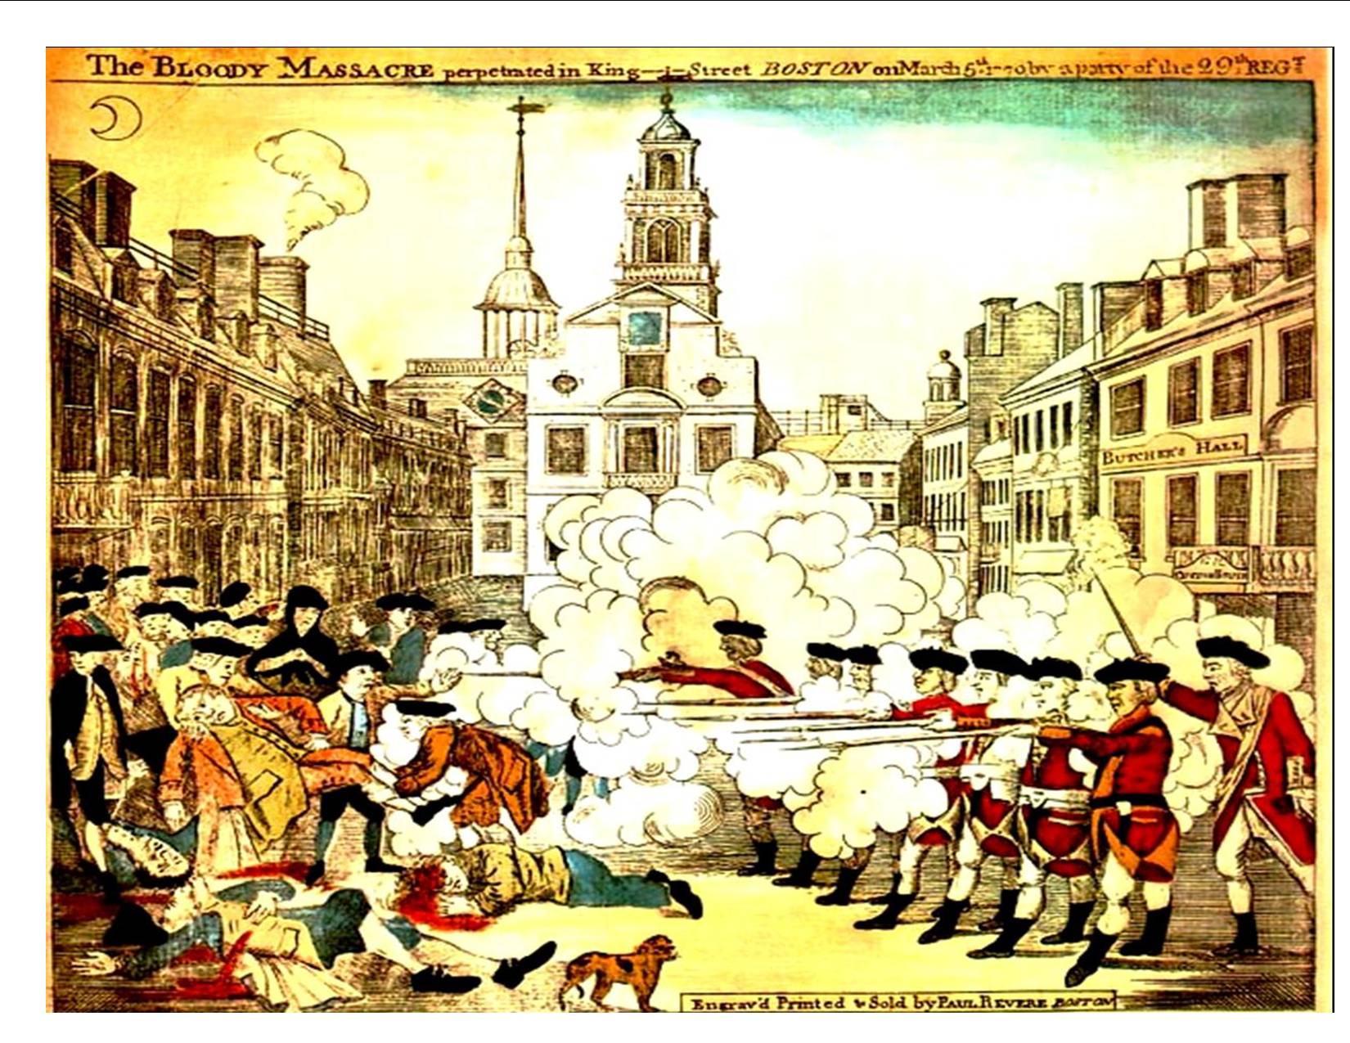

Slide 29
Boston Massacre: Paul Revere Painting
Observe:(3)
What do you notice in the painting?
Reflect:(2)
What can you infer from the painting and background info?
Question:(1)
What do you wonder?

Slide 30
Boston Massacre Video: Mr. Mills
Video Clip
What to watch/listen for:
Why is this event considered a controversy?
Listen for the 5W’s

Slide 31
Fri Warm Up 9/30
Plus/Delta on a color sticky
Different color for different class
Plus: What is working well in Social Studies??
Delta: What could we “tweak”/”improve”/maybe change or modify??

Slide 32
Friday Overview
DBQ: Was this a defenseless killing or an act of self-defense??
Break your group of 4 into (2 and 2)
Choose 3 Primary Sources to focus on this hour. (Patriot and British)
Don’t do #7
Label in spiral, Primary Source #___(Viewpoint) (Patriot, Loyalist, British??)
Answer the questions in complete sentences.

Slide 33
Mon Warm Up 10/3
Question: Describe a situation/circumstance/event in your life you feel was unfair.
Brochures: Fill out effort section
Late Work/Forgot to turn it in: You’ve had a month and I have been lenient with some of you with practice assignments and assessments. No More...It’s not preparing you for high school!!
Gum in the Room! Beware!!

Slide 34
Weekly Outlook
Monday: Group Work. Primary Source documents on Boston Massacre
Tuesday: CER Graphic Organizer Boston Massacre
Wednesday: Work Day on Domino Timeline (#5 Boston Massacre, #6 Tea Act, #7 Boston Tea Party
Thursday: SUB (Work on Boston Massacre Paper and Timelines)
Friday: Boston Massacre Mini-Debate

Slide 35
Monday
Agenda: Only day left to finish the documents
Finish your primary source documents and questions with your partner..(30-40 min)
Your evidence for the essay comes from these documents!!
Essential question: “Was this a defenseless killing or an act of self-defense?”
Domino Timelines if you finish early!

Slide 36
Tuesday Warm Up-Take a picture of these questions with your phone.
A British view of Bostonian rebellion
Why did a group of Bostonians attack John Malcom?
Explain how the artist has represented the political, economic, and social unrest in Boston through specific details
What is the artist attempting to say in the painting?

Slide 37
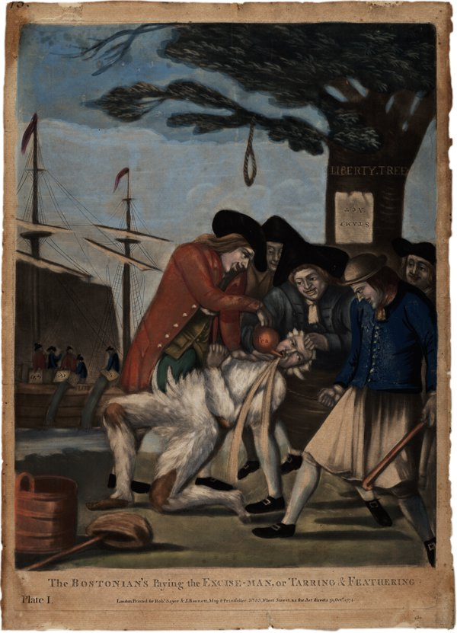
Monday Warm Up

Slide 38
Claim Example
What is the purpose of a claim?
Do you believe it is a narrow/specific focus statement or an overarching statement about the topic/question?
Example Prompt: Describe who you believe is the best team in the NFL today.
I think the Denver Broncos are an awesome team because they have players like Von Miller.
The Denver Broncos are the most complete football team in the NFL today.

Slide 39
Claim
Boston Massacre Claim:
Question: Is this a defenseless killing or self-defense?
Don’t go into specific detail in your claim about the massacre. You will do this later in your paper.

Slide 40
Boston Massacre Claims
Don’t use the “I believe, I think, etc.” to start your paper. I know you think that……that’s why your name is on the paper.
Make your claim and be confident with that statement.
Claim: The Boston Massacre was……………….
-Claim: This should address what the Boston Massacre was and the impact it had on colonists and the British

Slide 41
Tue Agenda
Where are we going today?
Claim/Evidence/Reasoning Graphic Organizer
-Claim: Choose one side or the other.
-Evidence: Needs to be from the documents #1-6. Cite your evidence (Document #2)
-Reasoning: Explains your evidence. Ties it to the claim.
2. Start your One and Final Draft of Boston Massacre Essay………..Due Friday 10/7

Slide 42
Wed Workday
Tax Day :) _______________
Reminder: Sub Tomorrow, but I am in the building.
Finish your Graphic Organizer
-Model to get started on Doc Camera
Work on Domino Timeline

Slide 43
Wed Warm Up
Write this question in your warm up section and be ready to answer.
Video Question: What was the cause and effect of the Boston Tea Party?
Tea Act/Boston Tea Party
Who was involved?
What were the main events to happen?
Where did this happen?
When did the Act/Tea Party occur?
Why are these “dominos”?

Slide 44
Friday Warm Up
Take out 3 Highlighters and your Boston Massacre Essay.
Use 1 color to highlight your claim/counterclaim.
Use a different color to highlight your evidence.
Use another color to highlight your reasoning.

Slide 45
Mini Debate Prep Sheet
Prepare for Mini-Debate-Take out a sheet of paper
Which side are you on?
List 3 main arguments for why you feel your side is right.
Predict the other side’s arguments-How can you defeat their arguments?
What evidence can you use?

Slide 46
Mini Debate-Boston Massacre (15 min)
Was the Boston Massacre a defenseless killing or an act of self-defense?
Window=British Side Counters=Patriot Side
You 3 opportunities total to speak.
Everyone will stand in a line and step forward when they want to speak.
I will score the fight/debate.
Winning side gets MO BUCKS!!!!

Slide 47
Mon Warm Up 10/10
Extended Warm Up
Pg 70-71 in your textbook. Individual Close Read. All of 5.6
How did Lord North think he could trick the colonists?
New Grades are posted
Domino Timelines due Thur

Slide 48
Causes of the American Revolution Dominos
French/Indian War: Monday
Proclamation of 1763: Tuesday
Stamp Act : Tuesday
Townshend Act: Wed
Boston Massacre: Thur-Tuei
Tea Act:Wed
Boston Tea Party: Thur/Fri
Intolerable Acts:Mon Oct 10th
Lexington/Concord: Tue Oct 11th

Slide 49
Monday Agenda: Tea Act/Boston Tea Party
Individual Read
Read the Play
Domino Sheet-#6 Tea Act and #7 Boston Tea Party
Tea Act/Boston Tea Party
Who was involved? (Main Groups)
What were the main events to happen?
Where did this happen?
When did the Act/Tea Party occur?
Why are these “dominos”?

Slide 50
Closure-Exit Ticket
Explain how the Boston Tea Party fits in with the idea of the Domino Effect. (What caused the BTP to happen?)
French and Indian War
Proclamation of 1763
Stamp Act
Townshend Acts
Boston Massacre – Monday and Tuesday
Tea Act-
Boston Tea Party –
Intolerable Acts –
Lexington and Concord –

Slide 51
Tue Warm Up 10/11
What similarities do you see in the Boston Massacre and Boston Tea Party?

Slide 52
Tue Agenda
Intolerable Acts and Lexington/Concord
Partner Read. Respondent/Questioner
Purpose of doing this.
Example of a Good Question to ask/Not Good. Page 72.
What did they throw into the sea?
Describe the new “issue” in the colonies.

Slide 53
Wed Warm Up 10/12
Set Up your Spirals for Unit 2 American Revolution
Warm Up: Create a solution to the problem that is happening with the colonists and the British. For example, taxes have been a problem between the two groups. (War is not an option!)

Slide 54
Wed: Dec of Independence
Ch 6 Declaration of Independence (pg 79)
Read Patrick Henry's famous speech about freedom at the bottom of the page…”Gentlemen may cry…..
Describe what you believe Henry means, “I know not what course others may take; but as for me, give me liberty, or give me death!”

Slide 55
6.2 The War Begins
Cornell Notes(Two Column)
George Washington and the Continental Army | What was the Continental Army? Why choose George Washington?
Battle of Bunker Hill | What happened here at Breed’s Hill and Bunker Hill? What did both sides find out after this battle?

Slide 56
6.3 The Siege of Boston
Cornell Notes(Two Column)
Ticonderoga | Describe what Washington did to prepare in its “siege” of Boston. Define siege
The British Abandon Boston | Why did the British abandon Boston?

Slide 57
Thur Warm Up 10/13
Scenario: You have just turned 18 and you want to move out of your parents house and start a new life on your own. Create a 2-column chart that describes the pros and cons of not living with your parents anymore.
Pros | Cons

Slide 58
Thursday
Lexington Basics
What happened:
Why is this important:

Slide 59
Fri Warm Up-You will turn in your Domino Timeline before we start the test
Review for the Test with a partner near you
1. Questioner/Respondent
-Use your timeline/book and ask your partner a question about one of the causes, then switch.
Example:
1. What was “taxation without representation”?
2.Argue why “taxation without representation” was not fair

Slide 60
Unit 2 American Revolution

Slide 61
Warm Up Wed:Declaration of Independence
-What does the visual metaphor on page 79 represent?
Battle of Bunker Hill
-Review. What happened here? What did this show Americans and the British?
Video clip on Bunker Hill

Slide 62
Dec of Independence
Partner Dissection of Dec of Independence
Choose 2 Areas to analyze
What do you want to declare yourself independent from?
School or Personal or a combo of both
When in the course of human events it becomes necessary for …………………..

Slide 63
Dec of Independence
Take 5 minutes and share what you want to be independent from.
-What I would like to be independent from?
-Why would this benefit your life?

Slide 64
Thur Warm Up
“Life, Liberty, and the Pursuit of Happiness” Describe what you believe this means and how it applies to you specifically.

Slide 65
Picture Analysis-pg 86
What differences do you see between the two armies?
What inferences can you draw about these armies?

Slide 66
American/British Strengths and Weaknesses
 | Strengths | Weaknesses
American
British

Slide 67
Exit Ticket
Based on the evidence who should win this war and why?

Slide 68
Strengths and Weaknesses Analysis
A. Factors favoring Britain
1. British government resources are inexhaustible by colonial standards.
2. British government much more stable.
3. British had a veteran army.
4. Veteran officers.
5. US Second Continental Congress young, inexperienced by British standards, not ready to fight a war by any means
6. Continental Army was small and poorly supplied.
7. England had world's
greatest navy.
8. Britain had substantial support within colonies.
Factors favoring the Rebels
1. US had advantage of fighting on home soil.
2. UK troops needed weeks, sometimes months to get troops and supplies to America.
3. US troops more motivated than their counterparts: Fighting for independence from Britain.
4. British Army a mercenary army.
5. British officers were aristocrats; they bought bought their rank and were adventure seekers.
6. Washington good leader

Slide 69
Wed Warm Up Dec 3rd
MO BUCK MADNESS!!!!!!!
Writing Claim Practice
Prompt: Justify what you believe the best fast food restaurant is and the qualities that make this restaurant superior to the others.
Partner Share

Slide 70
Boston Massacre News Report
Film room: On Task/Use Time Wisely/Throw poster away when your done filming.
Due Friday
Attach script to the packet
Send video to my school email jmogensen@sd27j.org

Slide 71
Letter to the Editor-Assessment Grade
Graphic Organizer
Letter
Rubric
Prompt:Describe whether you believe The Boston Massacre was an act of self defense or a defenseless killing? Why?
Claim: Answers the prompt and doesn’t use “I” statements
Evidence: Your evidence should come from the Primary Source packets. Cite evidence with quotes and document your sources (Document 1) (Document 2) etc
Reasoning: Why is this evidence important to your claim of self-defense or defenseless killing?

Slide 72
Pearl Harbor
Essential Question: What was the impact of Pearl Harbor? (Top of your page)
Primary Source: What observations can you make from this letter? What inferences can you make? Who do you believe wrote this?
Video: Why choose to attack this day? Describe the importance of the Japanese not sending a “Third Wave” attack. What was the effect of this event on the U.S.?

Slide 73
Wed Warm Up 12/10
What would you declare yourself independent from, if you could? Why?

Slide 74
6.4-6.6 Topics (pgs 82-84) Groups of 3-Line Up (Foods-Alpha)
Close Read your Section. Look for the Main Idea
Two Sentence Description-Main Idea of the Section
Olive Branch Petition
Common Sense
Natural Rights
The Kings Crimes
Debate over Slavery
Independence Day
Olive Branch | Common Sense
Natural Rights | The King Crimes
Debate over Slavery | Independence Day

Slide 75
Campfire
Talk about your topics, as you sit around the campfire
Explain what you read
Class Review-Random group choose

Slide 76
Exit Ticket
Why did the colonists want to declare independence from Britain?

Slide 77
Fri Warm Up 12/12
Quietly read the chapter summary on page 85 to prepare yourself for the quiz on Ch 6 Declaration of Independence.
Summarize this chapter in 2-3 sentences.

Slide 78
Tue Warm Up
Have your textbook ready to Check In/Check Out, as we are going to the library first thing.
Turn in your HW from last night to the basket.
Geography Challenge pg 98, Questions 2,3,4

Slide 79
Wed Warm Up
Geo Challenge pg 99. The Battle of Yorktown
Questions #2,3,4

Slide 80
Valley Forge/Monmouth
Describe the physical condition of the soldiers of the men at Valley Forge.
Why did they settle at Valley Forge?
Discipline: Give example from the video
Von Steuben: Who is this guy and describe his significance
What mistake did Charles Lee make at Monmouth? What was the outcome of the Battle of Monmouth?

Slide 81
Thursday Warm Up
Business as usual……You will need all your materials today!!
Collect and count your MO Bucks as a Revolutionary War team
Expectations for Outside today

Slide 82
Warm Up
Claim Practice: Write a Claim for the prompt on the Revolutionary War.

Slide 83
Fri Warm Up-Friday Fun Competition
1 Sheet of Paper and a Partner
United States History

Slide 84
Station Set Up
Talk as a Team. There may not be a sheet for everyone. This is a group activity, not an individual assignment. Use your text as an additional resource.
Activities Pages
10 min per station. Timer.
Essential Question: Describe how the Patriots were able to defeat the British in the American Revolution and gain their independence. Include at least 3 different reasons why they were successful in your response. Use multiple sources as evidence to justify your response.
Objective: You are researching and analyzing different aspects of the Revolutionary War why they are significant.

Slide 85
Station Topics
Important People
Battles
Allies
Women’s Role
African Americans
Weapons/Tactics
Valley Forge
Treaty of Paris

Slide 86
2015: New Year, New Changes
Sit in your Seat close to your old assigned seat
Morning Assembly Schedule
7:30-7:50
-New Assigned Seats
-ID Checks
-Changes for lining up/entering building
Between A and B Learning Communities outside, both sides

Slide 87
Movement: Body Check
“At Stuart Middle School, we display excellence by coming to school to be a learner and by demonstrating safe, responsible, and respectful behavior.”
Voice Level=0-2
Right Side=Walk on the right with
Face Forward
Hands and Feet (to yourself)
Citations for any infraction of these rules will be given by any adult in the building.

Slide 88
Tue Warm Up 1/6/15
Expectation Reminder: All Warm Ups (unless I tell you different) need to be in complete sentences.
What is your goal for Social Studies this year? How are you going to achieve this goal (be specific)?

Slide 89
Timeline of the Revolution-
Battle of Bunker Hill
Battle of Yorktown
Declaration of Independence
Common Sense
Olive Branch Petition
Battle of Monmouth
Battle of Trenton
Winter at Valley Forge

Slide 90
Requirements for the Events
When was this event?
Who was involved?
How did this help in the American’s achieving independence and winning the war?

Slide 91
Final Revolution Prompt
Describe how the Patriots were able to defeat the British in the American Revolution. Include at least 3 different reasons why they were successful in your response and use appropriate evidence/reasoning to justify your claim.
Use textbook and station notes to assist you in your evidence/reasoning.
Examples of Reasons: American Strengths, Battles, People, Books, Events, etc

